Slide 1
Learning Grounded Meaning Representations with Autoencoders Carina Silberer and Mirella Lapata
Presenter: Naveen Madapana
A new learning model that uses autoencoders to joint embeddings of images and text.
CS – 590 : Machine Learning for Natural Language Processing
Purdue University
Notes:
In one sentence, this paper proposes a new deep learning model to find joint embeddings of images and text combined.

Slide 2
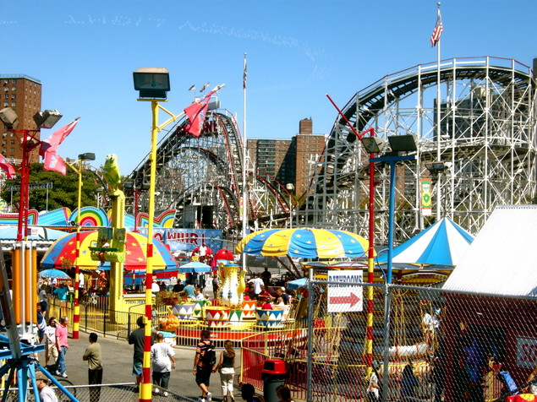
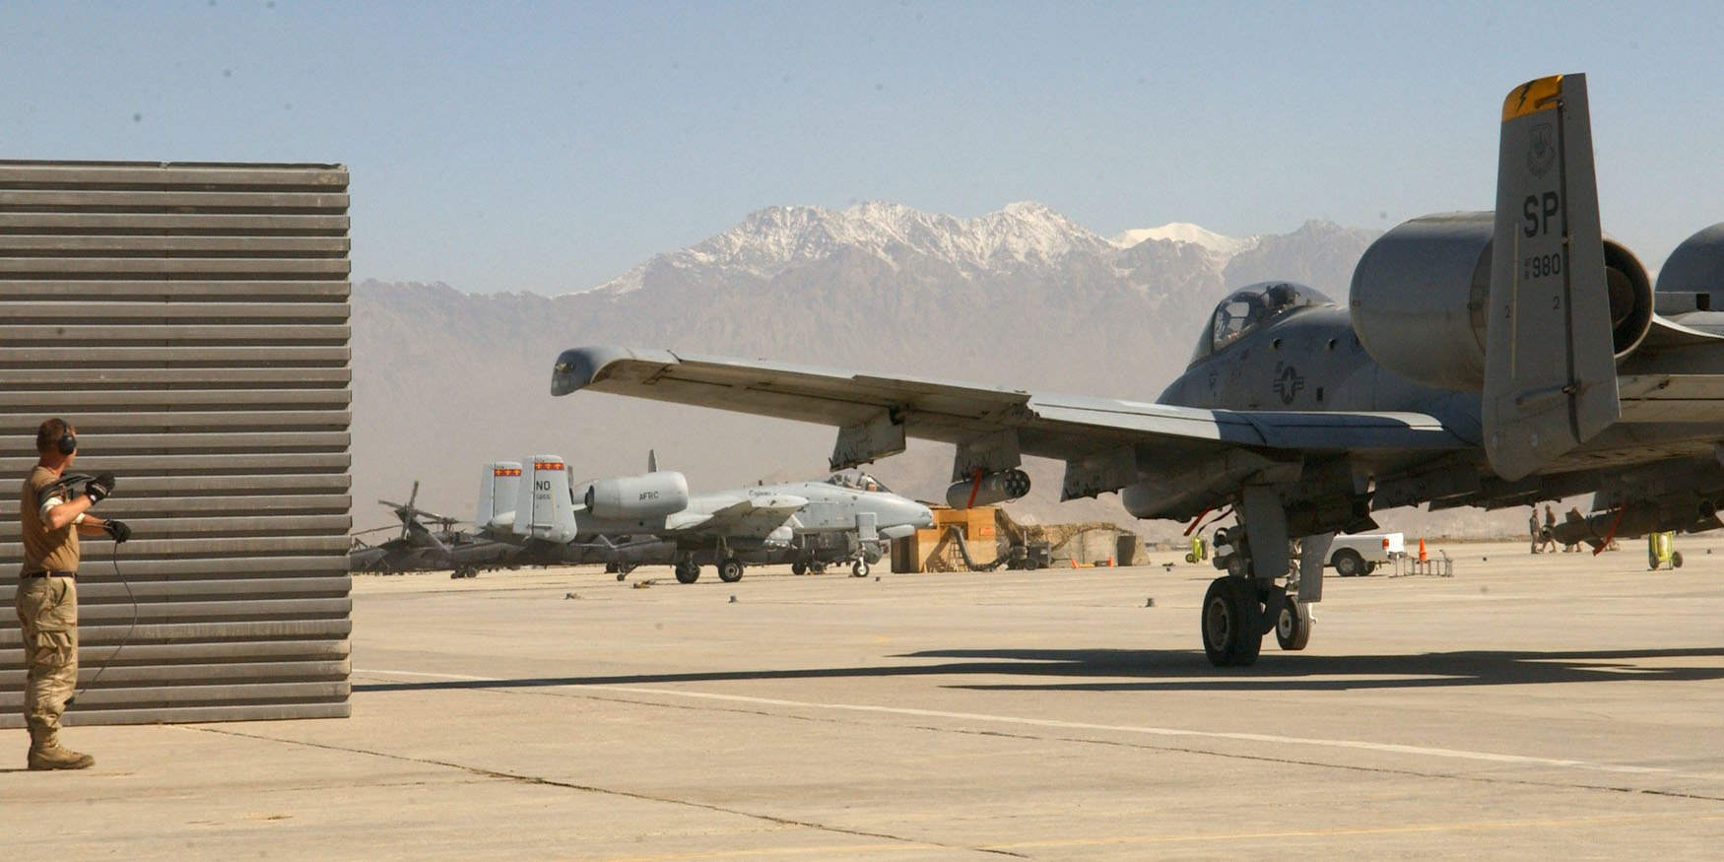
A park with rides, games, and other forms of entertainment. [Amusement Part]
A military facility that houses air personnel and equipment, and is used for training and other operations. [Air Base]
Both image and text provide similar information
Is the information from the two modes supplementary or complementary ?
Is the image embedding and word embedding same ? Ideally, they should lie closer on a hyperplane.
Hypothesis : Joint embeddings provide more information.
CS – 590 : Paper Presentation
Purdue University

Slide 3
Some Insights
Naïve way to create joint embeddings
Fusing/concatenating the embeddings of text and images
Disjoint learning
Meaning representation is not grounded in multiple modalities
Idea is to jointly learn the embeddings using independently trained autoencoders
CS – 590 : Paper Presentation
Purdue University

Slide 4






Reconstructed Input:
$$x′$$
$${W^{3}}^{T}$$
Autoencoders
with tied weights
$${W^{2}}^{T}$$
$$W^{3}$$
$$W^{1}$$
Input:
$$x$$
CS – 590 : Paper Presentation
Purdue University

Slide 5









Reconstructed Input : $x′$
Reconstructed Input : $y′$
$${W^{3}}^{T}$$
$${W^{4}}^{T}$$
Visual Information
Attributes of images
Embeddings
Int. layers of CNNs
$${W^{2}}^{T}$$
$${W^{2}}^{T}$$
Textual Information
POS Tags
Word embeddings
Co-occurrence
$$W^{3}$$
$$W^{4}$$
$$W^{1}$$
$$W^{2}$$
Visual Input : $x$
Textual Input : $y$
CS – 590 : Paper Presentation
Purdue University

Slide 6





$${W^{5}}^{T}$$
New Auto Encoder
$$W^{5}$$
$$W^{3}$$
$$W^{4}$$
Pre-trained before
$$W^{1}$$
$$W^{2}$$
Visual Input : $x$
Textual Input : $y$
CS – 590 : Paper Presentation
Purdue University

Slide 7






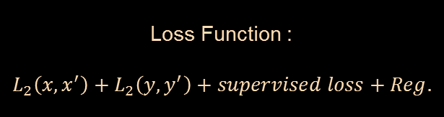

$$<x′,y′>$$
$${W^{1}}^{T}$$
$${W^{2}}^{T}$$
Loss Function :
$$L_{2}\left(x,x^{′}\right)+L_{2}\left(y,y^{′}\right)+supervised loss+Reg.$$
$${W^{3}}^{T}$$
$${W^{4}}^{T}$$
$${W^{5}}^{T}$$
$$W^{6}$$
$$Class Labels$$
$$W^{5}$$
$$W^{3}$$
$$W^{4}$$
$$W^{1}$$
$$W^{2}$$
$$<x,y>$$
CS – 590 : Paper Presentation
Purdue University

Slide 8

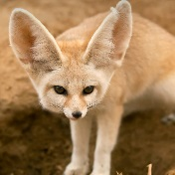
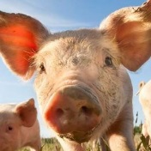
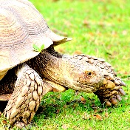

Has stripes ?
Tiger
Kangaroo
Brown color ?
Pig
Lives in on land ?
Horse
Large ears
Tortoise
Small animal
Rat
Animal Images
Semantic Descriptors (SDs)
Animal Name
CS – 590 : Paper Presentation
Purdue University

Slide 9
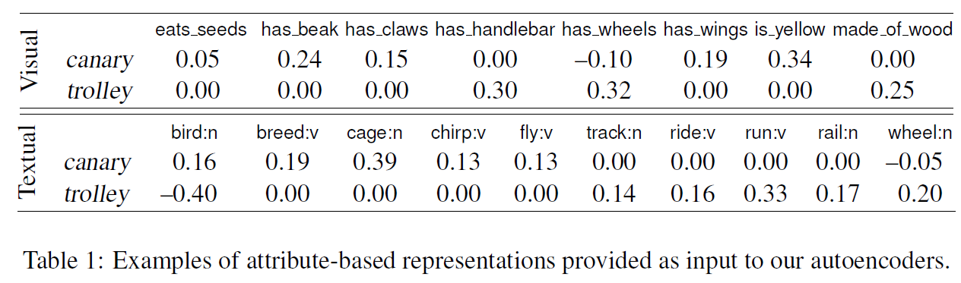
Manual Annotations
McRae’s paper – provides list of nouns and their semantic attributes for both visual and semantic settings
For some nouns, images are acquired from Image Net
Visual and Textual annotations: Humans annotated visual attributes for each class
Features are outputs of attribute based classifiers
CS – 590 : Paper Presentation
Purdue University

Slide 10
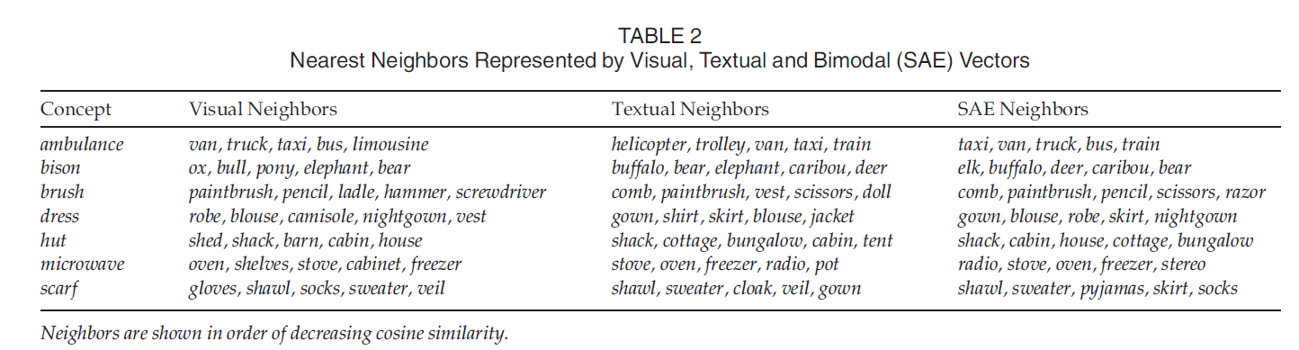
Visual and Textual Neighbors
CS – 590 : Paper Presentation
Purdue University

Slide 11

Experiments and Evaluation
Word Similarity task
Given two words (airplane and truck)
How similar they are in terms of visual and semantic similarity
Metrics : Correlation with human predictions
Spearman's $ρ$
CS – 590 : Paper Presentation
Purdue University

Slide 12
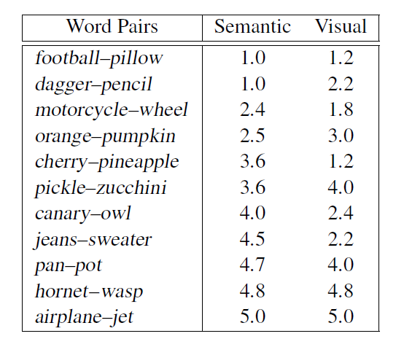
Visual and Semantic Similarity
Human Annotated
CS – 590 : Paper Presentation
Purdue University

Slide 13
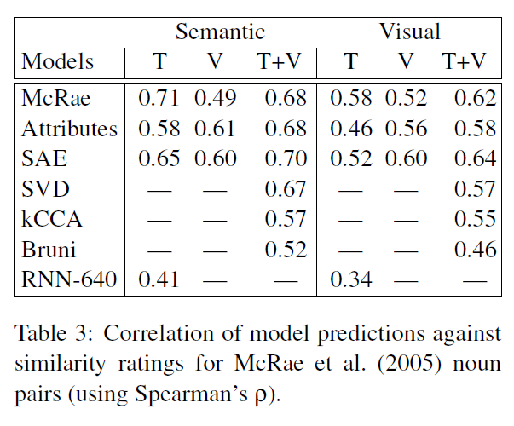
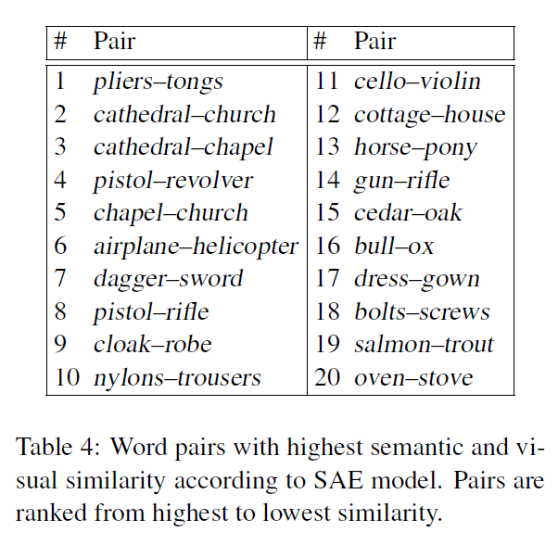
Semantic Similarity
Visual Similarity
Text – T
Visual – V
Human Performance
Inputs to AE
Proposed
CS – 590 : Paper Presentation
Purdue University

Slide 14
$$<x′,y′>$$
$${W^{1}}^{T}$$
$${W^{2}}^{T}$$
Loss Function :
$$L_{2}\left(x,x^{′}\right)+L_{2}\left(y,y^{′}\right)+supervised loss+Reg.$$
$${W^{3}}^{T}$$
$${W^{4}}^{T}$$
$${W^{5}}^{T}$$
$$W^{6}$$
$$Class Labels$$
$$W^{5}$$
$$W^{3}$$
$$W^{4}$$
$$W^{4}$$
$$W^{1}$$
$$W^{2}$$
$$W^{2}$$
$$<x,y>$$
CS – 590 : Paper Presentation
Purdue University

Slide 15
Conclusions
Humans differentiate very well between visual and textual similarity.
The chosen baselines are not convincing because they are comparing against themselves
It is interesting to apply this technique with dynamic objects like gestures, speech and text combined.
CS – 590 : Paper Presentation
Purdue University

